Slide 1
Advanced Control Methods: Final Project
Cv based ball tracking and estimation its physical properties
Mert Alper

Slide 2
Outline
Problem Statement
Computer Vision Algorithm
Mathematical Algorithm
Results

Slide 3
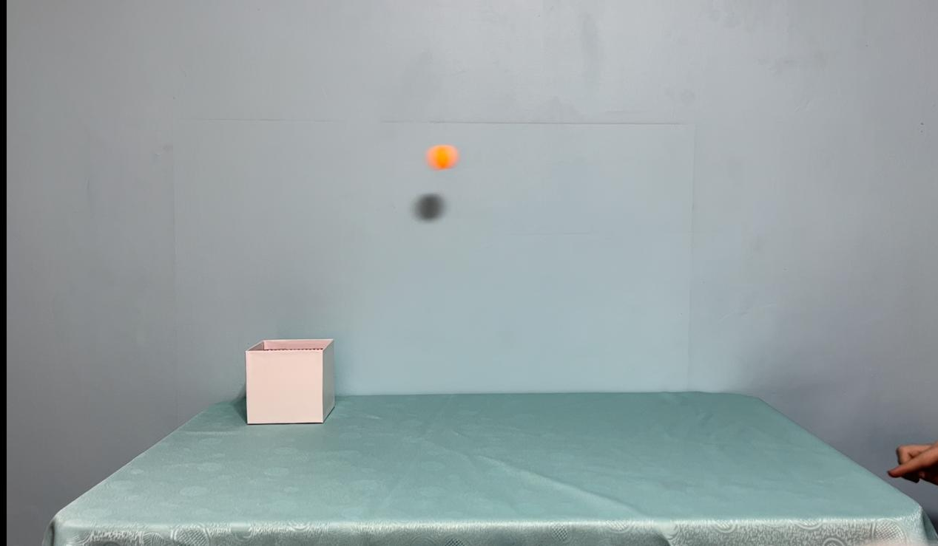
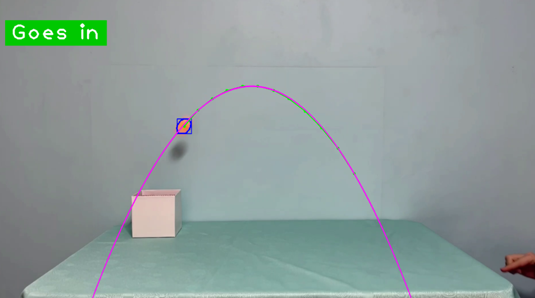
Problem Statement
This project aims to track the ping-pong ball with computer vision and estimate if the ball is gonna go into the box or not.

Slide 4
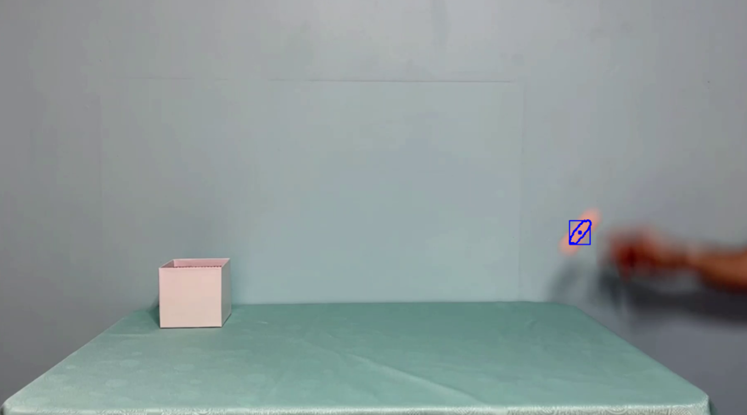

Computer Vision Algorithm
Finding the HSV values from the image
Applying HSV values to the video
Masking of the ball
Finding the contours of the ball

Slide 5
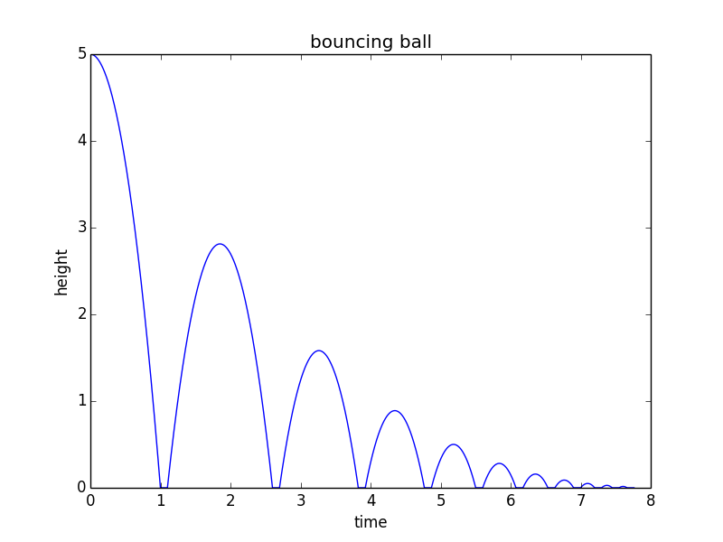
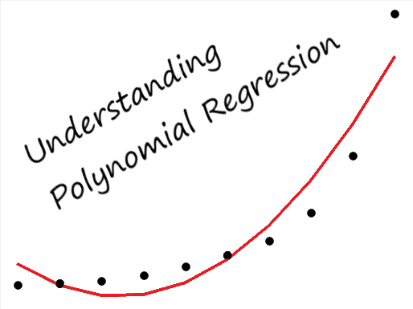
Mathematical Algorithm
Movement of the bouncing ball
Unknown dynamics of the ping-pong ball
Polynomial regression
Order of the equation

Slide 6
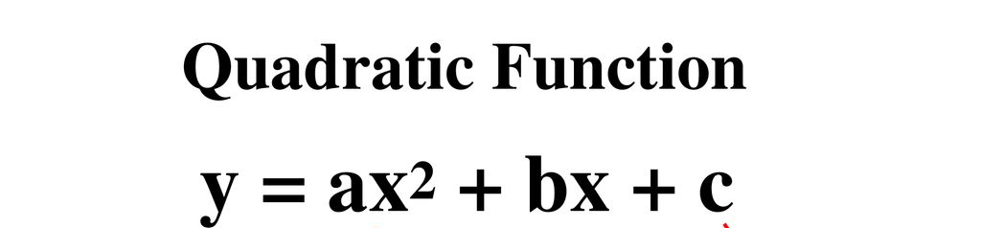
Mathematical Algorithm
Polynomial regression with a quadratic function
We can find a,b and c from the positions of the ball (np.polyfit function)
After all that, we can put the x and y values of the box and check if the ball is going in.

Slide 7
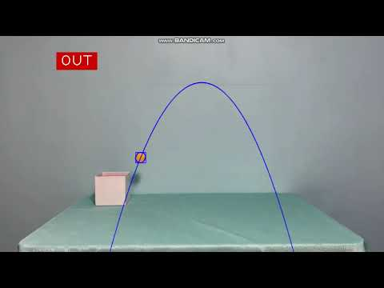
Results
6 different scenarios are tested.

Slide 8
Thanks for listening
Questions?

